Slide 1
Optimizing Converged Cisco Networks (ONT)
Stretnutie 1: Úvod do problematiky

Slide 2

Úvod do QoS

Slide 3
Prostriedky pre kvalitu služby
Čo je to kvalita služby?
Miera uspokojenia používateľa tejto služby s jej úrovňou
Veľmi subjektívny pojem
Silne závislý na povahe služby
Prečo potrebujeme riešiť kvalitu služby?
Pretože IP siete, s ktorými pracujeme, sa ku každému toku dát zvyknú chovať rovnako
Toky dát ale nie sú rovnocenné
Bezuzdné zvyšovanie kapacity liniek nie je ani ekonomické, ani dostupné

Slide 4
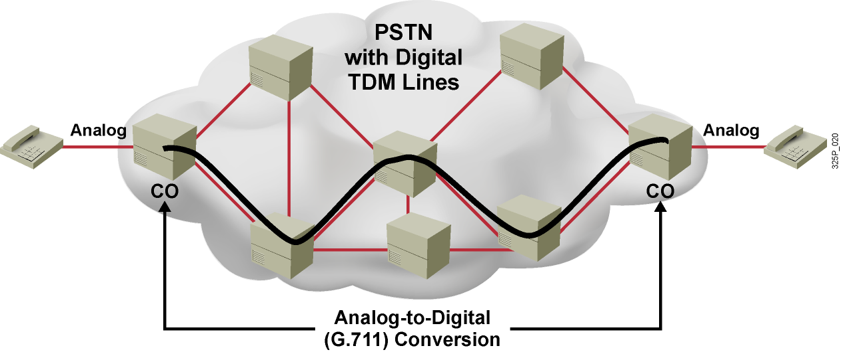
Prenos hlasu v sieťach s prepínaním okruhov
Analógové telefóny sa pripájajú k telefónnym ústredniam
Telefónne ústredne realizujú konverziu medzi analógovým a digitálnym signálom
Po zostavení hovoru sa telefónna sieť stará o to, aby hovor mal
Svoj vlastný vyhradený prenosový okruh
Synchrónny prenos s fixnou šírkou pásma a veľmi malým, konštantným oneskorením
Notes:
In PSTN environments, residential telephones connect to central office (CO) switches on analog circuits. The core network is composed of switches that are interconnected by digital trunks, as illustrated in Figure 2.3.1.1. When a caller places a call to a second telephone, the call setup stage occurs first. This sets up an end-to-end dedicated circuit (DS-0) for the call. The CO switch then converts the received analog signals into digital format using the G.711 codec.
During the transmission stage, the synchronous transmission sends G.711 bits at a fixed rate with a very low but constant delay. The circuit dedicates the whole bandwidth (64 kbps) to the call, and because all bits follow the same path, all voice samples stay in order. When the call finishes, switches release the individual DS-0 circuits, making them available for use by other calls.

Slide 5
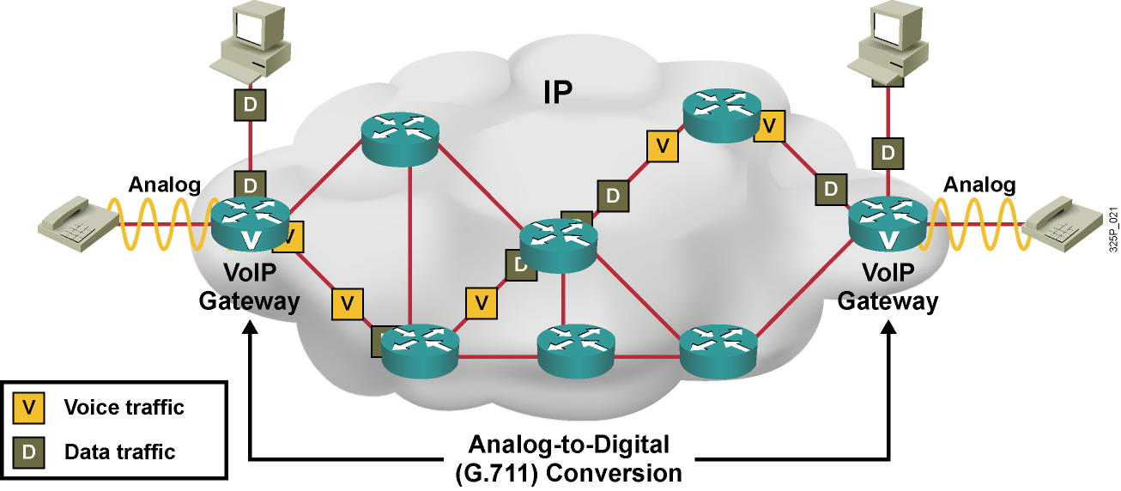
Prenos hlasu vo VoIP sieťach
Analógové telefóny sa pripájajú k hlasovým bránam
Hlasové brány realizujú konverziu medzi analógovým a digitálnym signálom
Po zostavení hovoru IP sieť poskytuje
Prenos individuálnych paketov sieťou nezávisle
Zdieľanú šírku pásma, vyššie a premenlivejšie oneskorenie
Notes:
In VoIP networks, analog telephones connect to VoIP gateways through analog interfaces. The gateways connect through an IP network, as shown here. IP phones connect to switches, and the switches in turn connect directly to routers.
When a caller places a call from one telephone to another telephone, the call setup stage sets the call up logically, but no dedicated circuits (lines) are associated with the call. The gateway then converts the received analog signals into digital format using a codec, such as G.711 or G.729 with voice compression.
During the transmission stage, voice gateways insert voice packets into data packets and then send the data packets, one by one, out to the network. The bandwidths of the links between the individual routers are not time‑division multiplexed into separate circuits but are single high-bandwidth circuits, carrying IP packets from several devices. As shown here, data and voice packets share the same path and the same links.

Slide 6
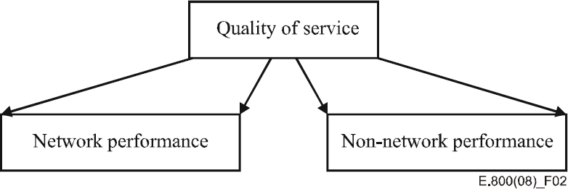
ITU-T Odporúčanie E.800
Kvalite služby sa venuje široká pozornosť aj zo strany normotvorných organizácií
ITU-T má rad odporúčaní, ktoré sa dotýkajú otázok kvality služby, SLA, jej hodnotenia atď.
E.800: Definitions of terms related to quality of service
NP: Prenosová rýchlosť, oneskorenie, jitter, stratovosť, ...
NNP: Čas zriadenia služby, trvanie odstránenia výpadku, tarify, ...
Picture retaken from ITU-T E.800 (09/2008), https://www.itu.int/rec/dologin_pub.asp?lang=e&id=T-REC-E.800-200809-I!!PDF-E&type=items

Slide 7
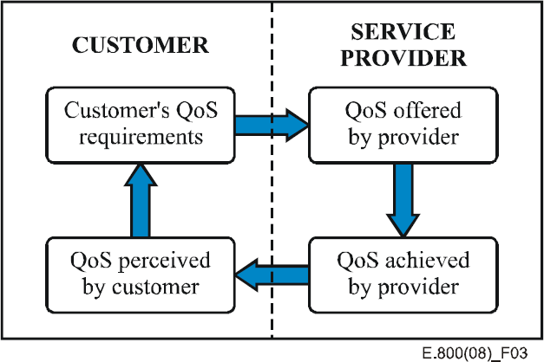
ITU-T Odporúčanie E.800
Podľa E.800:
Quality: The totality of characteristics of an entity that bear on its ability to satisfy stated and implied needs.
Service: A set of functions offered to a user by an organization.
Quality of Service: Totality of characteristics of a telecommunications service that bear on its ability to satisfy stated and implied needs of the user of the service.
Zákazníkovo vnímanie poskytovanej QoS sa môže líšiť od úrovne QoS, o ktorej sa operátor domnieva, že ju ponúka
Picture retaken from ITU-T E.800 (09/2008), https://www.itu.int/rec/dologin_pub.asp?lang=e&id=T-REC-E.800-200809-I!!PDF-E&type=items

Slide 8

Faktory ovplyvňujúce kvalitu služby

Slide 9
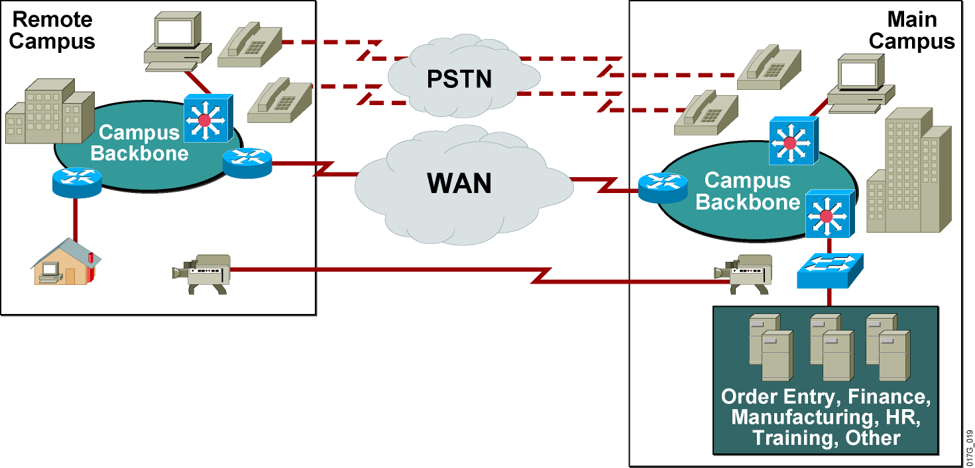
Tradičná nekonvergovaná sieť
Charakter dátovej prevádzky:
Zhluková
Odosielaná FIFO štýlom
Nenáročná na včasnosť doručenia
Krátke výpadky sú tolerovateľné
Notes:
Before converged networks were common, network engineering focused on connectivity. The rates at which data came onto the network resulted in bursty data flows. In a traditional network, data, arriving in packets, tries to acquire and use as much bandwidth as possible at any given time. Access to bandwidth is on a first-come, first-served (FIFO) basis. The data rate available to any one user varies depending on the number of users accessing the network at that time.
Protocols in nonconverged traditional networks handle the bursty nature of data networks. Data networks can survive brief outages. For example, when you retrieve e-mail, a delay of a few seconds is generally not noticeable. A delay of minutes is annoying, but not serious.
Traditional networks also had requirements for applications such as data, video, and systems network architecture (SNA). Since each application has different traffic characteristics and requirements, network designers deployed nonintegrated networks. These nonintegrated networks carried specific types of traffic: data network, SNA network, voice network, and video network.

Slide 10
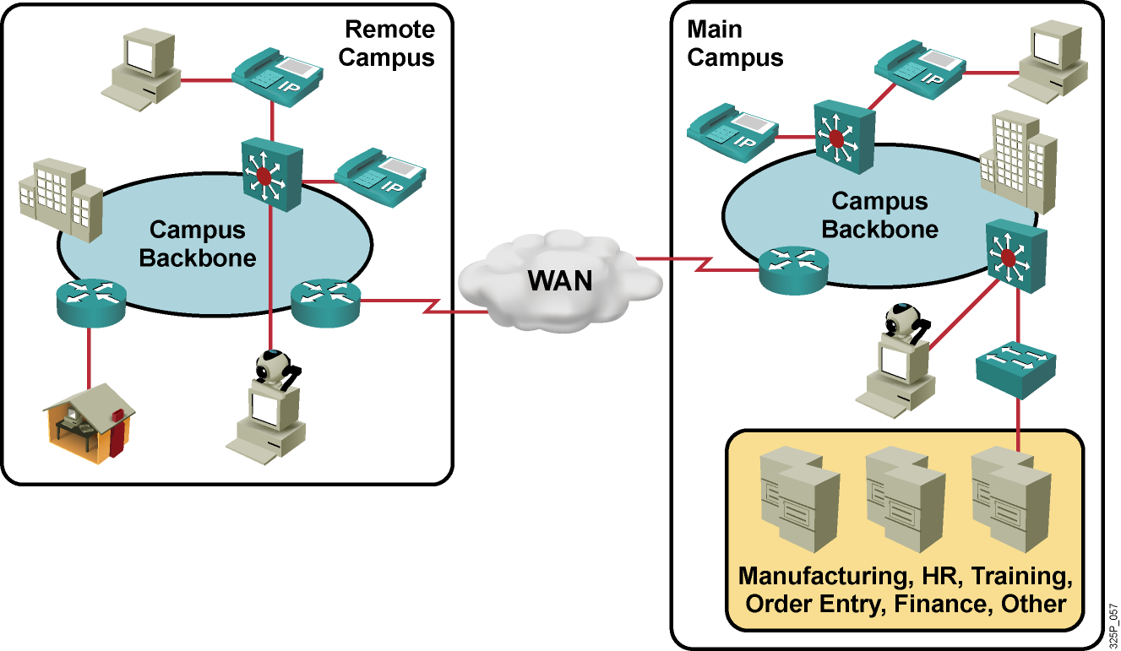
Problémy v konvergovanej sieti
Toky v konvergovanej sieti:
Pravidelné hlasové toky malých paketov súperia so zhlukovou dátovou prevádzkou
Časovo kritická prevádzka musí mať prioritu
Hlas, video, real-time aplikácie
Nemožno tolerovať ani krátke výpadky
Notes:
A converged network carries voice, video, and data traffic. These flows use the same network facilities. Merging these different traffic streams with dramatically differing requirements can lead to a number of problems. Key among these problems is that voice and video traffic is very time-sensitive and must get priority.
In a converged network, constant, small-packet voice flows compete with bursty data flows. Although the packets carrying voice traffic on a converged network are typically very small, the packets cannot tolerate delay and delay variation as they traverse the network. When delay and delay variations occur, voices break up and words become incomprehensible.
Conversely, packets carrying file transfer data are typically large and the nature of IP lets the packets survive delays and drops. It is possible to retransmit part of a dropped data file, but it is not feasible to retransmit part of a voice conversation. Critical voice and video traffic must have priority over data traffic. Mechanisms must be in place to provide this priority.
The key reality in converged networks is that service providers cannot accept failure. While a file transfer or an e-mail packet can wait until a down network recovers and delays are almost transparent, voice and video packets cannot wait. Converged networks must provide secure, predictable, measurable, and, sometimes, guaranteed services. Even a brief network outage on a converged network seriously disrupts business operations.
Network administrators and architects achieve required performance from the network by managing delay, delay variation (jitter), bandwidth provisioning, and packet loss parameters with quality of service (QoS) techniques.
Multimedia streams, such as those used in IP telephony or videoconferencing, are very sensitive to delivery delays and create unique QoS demands. If service providers rely on a best-effort network model, packets may not arrive in order, in a timely manner, or maybe not at all. The result is unclear pictures, jerky and slow movement, and sound that is not synchronized with images.

Slide 11
Faktory vplývajúce na kvalitu služby v paketovej sieti
Prenosová kapacita
Mnohé toky súperia o obmedzené množstvo prenosovej kapacity prepínačov, smerovačov a rozhraní medzi nimi
Celkové oneskorenie (pevná aj variabilná zložka)
Pakety musia prejsť cez početné sieťové zariadenia a prepoje, z ktorých každé vnáša svoju časť oneskorenia
Kolísanie oneskorenia (jitter)
Tok inej prevádzky popri hlasovej prevádzke vnáša náhodné zmeny v oneskorení
Straty paketov
Pri zahltení rozhrania sa pakety môžu zahadzovať
Notes:
With inadequate network configuration, voice transmission is irregular or unintelligible. Gaps in speech where pieces of speech are interspersed with silence are particularly troublesome.
Delay causes poor caller interactivity. Poor caller interactivity can cause echo and talker overlap. Echo is the effect of the signal reflecting the speaker voice from the far-end telephone equipment back into the speaker ear. Talker overlap is caused when one-way delay becomes greater than 250 ms. When this long delay occurs; one talker steps in on the speech of the other talker.
The worst-case result of delay is a disconnected call. If there are long gaps in speech, the parties will hang up. If there are signaling problems, calls are disconnected. Such events are unacceptable in voice communications, yet are quite common for an inadequately prepared data network that is attempting to carry voice.
The four major issues that face converged enterprise networks:
Lack of Bandwidth capacity: Large graphics files, multimedia uses, and increasing use of voice and video cause bandwidth capacity problems over data networks.
End-to-end delay (both fixed and variable): Delay is the time it takes for a packet to reach the receiving endpoint after being transmitted from the sending endpoint. This period of time is called the “end-to-end delay” and consists of two components:
Fixed network delay: Two types of fixed network delay are serialization and propagation delays. Serialization is the process of placing bits on the circuit. The higher the circuit speed, the less time it takes to place the bits on the circuit. Therefore, the higher the speed of the link, the less serialization delay is incurred. Propagation delay is the time it takes frames to transit the physical media.
Variable network delay: Processing delay is a type of variable delay and is the time required by a networking device to look up the route, change the header, and complete other switching tasks. In some cases, the packet must also be manipulated, as, for example, when the encapsulation type or the hop count must be changed. Each of these steps can contribute to processing delay.
Variation of delay (also called jitter): Jitter is the delta, or difference, in the total end-to-end delay values of two voice packets in the voice flow.
Packet loss: WAN congestion is the usual cause for packet loss and results in speech dropouts or a stutter effect if the play out side tries to accommodate for the loss by retransmitting previously sent packets.

Slide 12
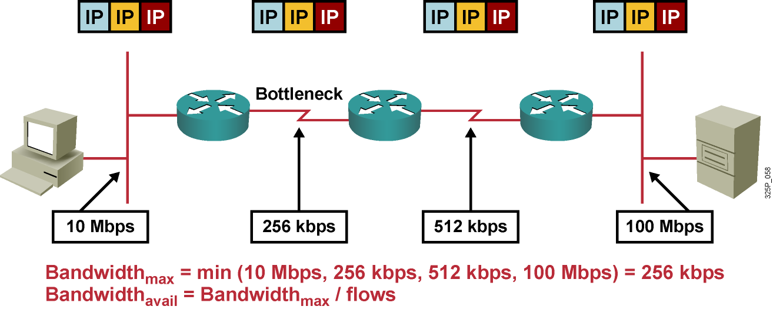
Disponibilná prenosová kapacita
Maximálna dostupná prenosová kapacita je kapacita najpomalšej linky
O túto prenosovú kapacitu sa uchádzajú mnohé toky, čím môžu znížiť jej dostupnosť pre ktorúkoľvek individuálnu aplikáciu
Prirodzene, nedostatok prenosovej kapacity má negatívny vplyv na aplikácie
Notes:
This example shows a network with four hops between a server and a client. Each hop uses different media with different bandwidths. The maximum available bandwidth is equal to the bandwidth of the slowest link.
The calculation of the available bandwidth, however, is much more complex in cases where multiple flows are traversing the network. In such cases, you must calculate average bandwidth available per flow.
Inadequate bandwidth can have performance impacts on network applications, especially those that are time-sensitive (such as voice) or consume a lot of bandwidth (such as videoconferencing). These performance impacts result in poor voice and video quality. In addition, interactive network services, such as terminal services and remote desktops, may also suffer from lower bandwidth, which results in slow application responses.

Slide 13
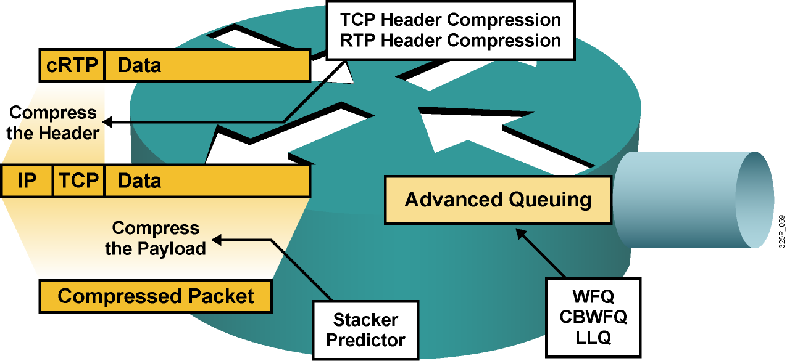
Ako získať disponibilnú prenosovú kapacitu
Zrýchliť linku (najlepšie, ale aj najdrahšie riešenie)
Využiť QoS prostriedky a dať prioritu dôležitým paketom (na úkor iných tokov)
Komprimovať obsah rámcov (to však trvá istý čas)
Komprimovať IP hlavičky (detto)
Notes:
Bandwidth is one of the key factors that affects QoS in a network; the more bandwidth there is, the better the QoS will be.
The best way to increase bandwidth is to increase the link capacity of the network to accommodate all applications and users, allowing extra, spare bandwidth. Although this solution sounds simple, increasing bandwidth is expensive and takes time to implement. There are often technological limitations in upgrading to a higher bandwidth.
The better option is to classify traffic into QoS classes and prioritize each class according to its relative importance. The basic queuing mechanism is First In First Out (FIFO). Other queuing mechanisms provide additional granularity to serve voice and business-critical traffic. Such traffic types should receive sufficient bandwidth to support their application requirements. Voice traffic should receive prioritized forwarding, and the least important traffic should receive the unallocated bandwidth that remains after prioritized traffic is accommodated.
Cisco IOS QoS software provides a variety of mechanisms to assign bandwidth priority to specific classes of traffic:
Priority queuing (PQ) or custom queuing (CQ)
Modified deficit round robin (MDRR) (on Cisco 12000 Series Routers)
Distributed type of service (ToS)-based and QoS group-based weighted fair queuing (WFQ) (on Cisco 7x00 Series Routers)
Class-based weighted fair queuing (CBWFQ)
Low-latency queuing (LLQ)
A way to increase the available link bandwidth is to optimize link usage by compressing the payload of frames (virtually). Compression, however, also increases delay because of the complexity of compression algorithms. Using hardware compression can accelerate packet payload compressions. Stacker and Predictor are two compression algorithms that are available in Cisco IOS software.
Another mechanism that is used for link bandwidth efficiency is header compression. Header compression is especially effective in networks where most packets carry small amounts of data (that is, where the payload-to-header ratio is small). Typical examples of header compression are TCP header compression and Real-Time Transport Protocol (RTP) header compression.

Slide 14
Efektívne využívanie prenosovej kapacity
Hlas (Najvyššia)
Dáta (Vysoká)
Dáta (Stredná)
Data (Nízka)
Hlas
LLQ
Kompresia RTP hlavičiek
1
1
2
2
4
3
2
1
1
3
3
3
Dáta
CBWFQ
Kompresia TCP hlavičiek
4
4
4
4
Pomocou frontových a kompresných mechanizmov je možné efektívejšie využívať dostupnú prenosovú kapacitu
Hlas: LLQ a kompresia RTP hlavičiek
Interaktívne toky: CBWFQ a kompresia TCP hlavičiek
Notes:
Example: Using Available Bandwidth More Efficiently
In a network with remote sites that use interactive traffic and voice for daily business, bandwidth availability is an issue. In some regions, broadband bandwidth services are difficult to obtain or, in the worst case, are not available. This situation means that available bandwidth resources must be used efficiently. Advanced queuing techniques, such as CBWFQ or LLQ, and header compression mechanisms, such as TCP and RTP header compression, are needed to use the bandwidth much more efficiently.
In this example, a low-speed WAN link connects two office sites. Both sites are equipped with IP phones, PCs, and servers that run interactive applications, such as terminal services. Because the available bandwidth is limited, an appropriate strategy for efficient bandwidth use must be determined and implemented.
Administrators must chose suitable queuing and compression mechanisms for the network based on the kind of traffic that is traversing the network. The example uses LLQ and RTP header compression to provide the optimal quality for voice traffic. CBWFQ and TCP header compression are effective for managing interactive data traffic.

Slide 15
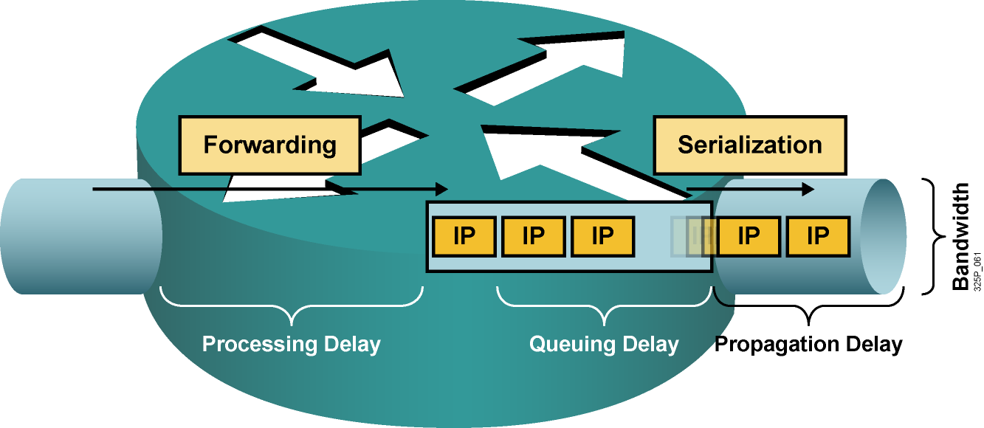
Druhy oneskorenia
Processing delay (oneskorenie pri spracovaní): Čas od prevzatia paketu zo vstupného rozhrania, jeho analýzy, cez smerovacie rozhodnutie až po jeho uloženie do výstupného frontu na výstupnom rozhraní
Queuing delay (oneskorenie vo fronte): Čas, ktorý paket strávi vo výstupnom fronte rozhrania
Serialization delay (serializačné oneskorenie): Čas, ktorý je potrebný na odoslanie paketu rozhraním danej prenosovej rýchlosti
Propagation delay (oneskorenie pri šírení): Čas, ktorý je potrebný na prechod signálu po danom fyzickom médiu
Notes:
Four types of delay:
Processing delay: Processing delay is the time that it takes for a router (or Layer 3 switch) to take the packet from an input interface and put the packet into the output queue of the output interface. The processing delay depends on various factors:
CPU speed
CPU use
IP switching mode
Router architecture
Configured features on both the input and output interfaces
Queuing delay: Queuing delay is the time that a packet resides in the output queue of a router. Queuing delay depends on the number of packets that are already in the queue and packet sizes. Queuing delay also depends on the bandwidth of the interface and the queuing mechanism.
Serialization delay: Serialization delay is the time that it takes to place a frame on the physical medium for transport. This delay is typically inversely proportional to the link bandwidth.
Propagation delay: Propagation delay is the time that it takes for the packet to cross the link from one end to the other. This time usually depends on the type of media that is being transmitted, be it data, voice or video. For example, satellite links produce the longest propagation delay because of the high altitudes of communications satellites.

Slide 16
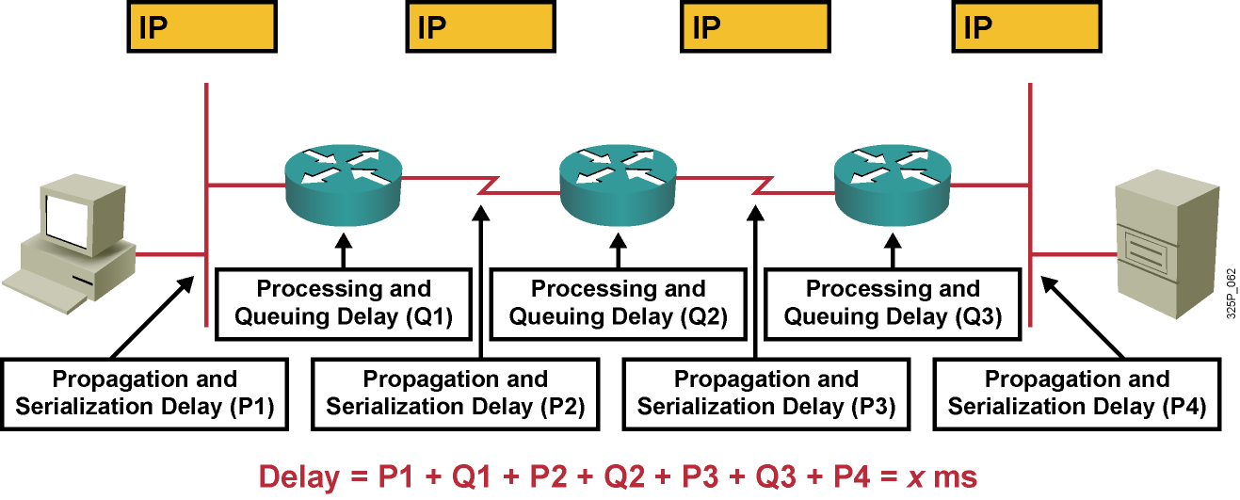
Dopad oneskorenia a jeho kolísania na kvalitu
Celkové oneskorenie: Súčet všetkých propagačných, procesných, serializačných a frontových oneskorení pozdĺž prenosovej trasy
V best-effort networks sú propagačné a serializačné oneskorenia pevné, zatiaľčo procesné a frontové oneskorenia sú náhodné
Notes:
End-to-end delay and jitter have a severe quality impact on the network:
End-to-end delay is the sum of all types of delays.
Each hop in the network has its own set of variable processing and queuing delays, which can result in jitter.
Internet Control Message Protocol (ICMP) echo (ping) is one way to measure the round-trip time of IP packets in a network.

Slide 17
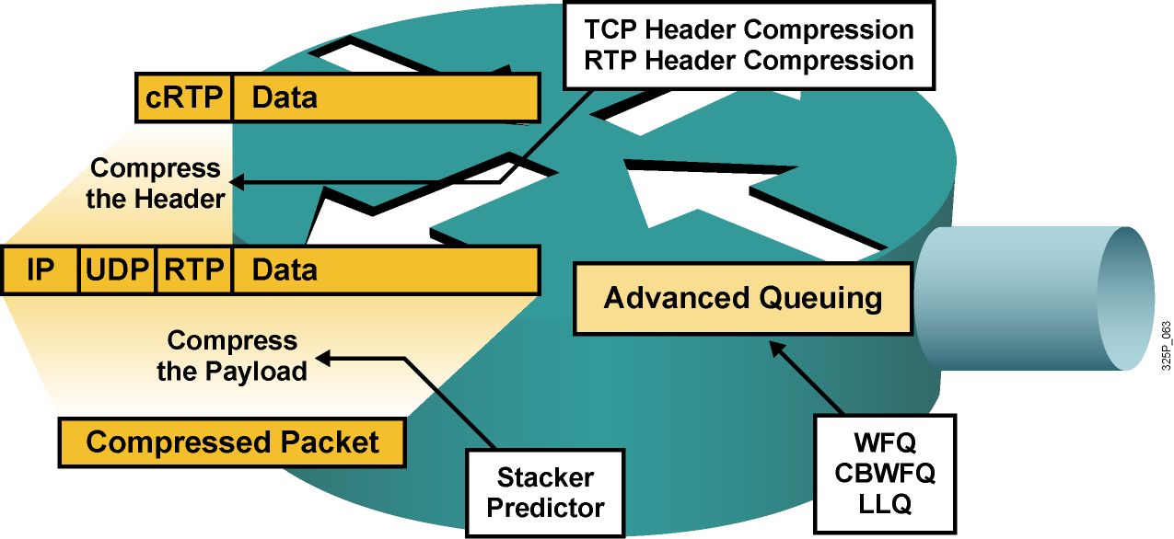
Ako znížiť oneskorenie
Zrýchliť linku (najlepšie, ale aj najdrahšie riešenie)
Dať prioritu dôležitým paketom
Umožniť úpravu prioritu dôležitých paketov
Komprimovať obsah rámcov (to však trvá istý čas)
Komprimovať IP hlavičky (detto)
Notes:
When considering solutions to the delay problem, there are two things to note:
Processing and queuing delays are related to devices and are bound to the behavior of the operating system.
Propagation and serialization delays are related to the media.
There are many ways to reduce the delay at a router. Assuming that the router has enough power to make forwarding decisions rapidly, these factors influence most queuing and serialization delays:
Average length of the queue
Average length of packets in the queue
Link bandwidth
Network administrators can accelerate the packet dispatching for delay-sensitive flows:
Increase link capacity: Sufficient bandwidth causes queues to shrink so that packets do not wait long before transmittal. Increasing bandwidth reduces serialization time. This approach can be unrealistic because of the costs that are associated with the upgrade.
Prioritize delay-sensitive packets: This approach can be more cost-effective than increasing link capacity. WFQ, CBWFQ, and LLQ can each serve certain queues first (this is a pre-emptive way of servicing queues).
Reprioritize packets: In some cases, important packets need to be reprioritized when they are entering or exiting a device. For example, when packets leave a private network to transit an Internet service provider (ISP) network, the ISP may require that the packets be reprioritized.
Compress payload: Payload compression reduces the size of packets, which virtually increases link bandwidth. Compressed packets are smaller and take less time to transmit. Compression uses complex algorithms that add delay. If you are using payload compression to reduce delay, make sure that the time that is needed to compress the payload does not negate the benefits of having less data to transfer over the link.
Use header compression: Header compression is not as CPU-intensive as payload compression. Header compression reduces delay when used with other mechanisms. Header compression is especially useful for voice packets that have a bad payload-to-header ratio (relative large header in comparison to the payload), which is improved by reducing the header of the packet (RTP header compression).
By minimizing delay, network administrators can also reduce jitter (delay is more predictable than jitter and easier to reduce).

Slide 18
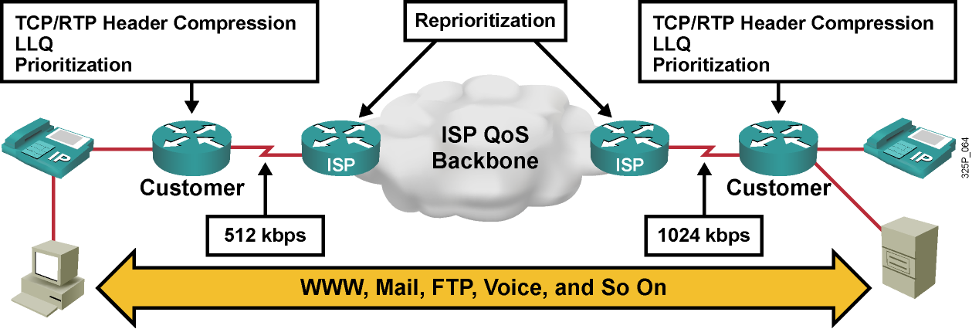
Znižovanie oneskorenia
Zákaznícke smerovače realizujú:
Kompresiu TCP/RTP hlavičiek
LLQ (Low Latency Queueing)
Prioritizáciu
Smerovače ISP realizujú:
Reprioritizáciu na základe dohodnutých QoS pravidiel
Notes:
In this example, an ISP providing QoS connects the offices of the customer to each other. A low-speed link (512 kbps) connects the branch office while a higher-speed link (1024 kbps) connects the main office. The customer uses both IP phones and TCP/IP-based applications to conduct daily business. Because the branch office only has a bandwidth of 512 kbps, the customer needs an appropriate QoS strategy to provide the highest possible quality for voice and data traffic.
In this example, the customer needs to communicate with HTTP, FTP, e-mail, and voice services in the main office. Because the available bandwidth at the customer site is only 512 kbps, most traffic, but especially voice traffic, would suffer from end-to-end delays.
In this example, the customer performs TCP and RTP header compression, LLQ, and prioritization of the various types of traffic. These mechanisms give voice traffic a higher priority than HTTP or e-mail traffic. In addition to these measures, the customer has chosen an ISP that supports QoS in the backbone.
The ISP performs reprioritization for customer traffic according to the QoS policy for the customer so that the traffic streams arrive on time at the main office of the customer. This design guarantees that voice traffic has high priority and a guaranteed bandwidth of 128 kbps, FTP and e-mail traffic receive medium priority and a bandwidth of 256 kbps, and HTTP traffic receives low priority and a bandwidth of 64 kbps. Signaling and other management traffic uses the remaining 64 kbps.

Slide 19
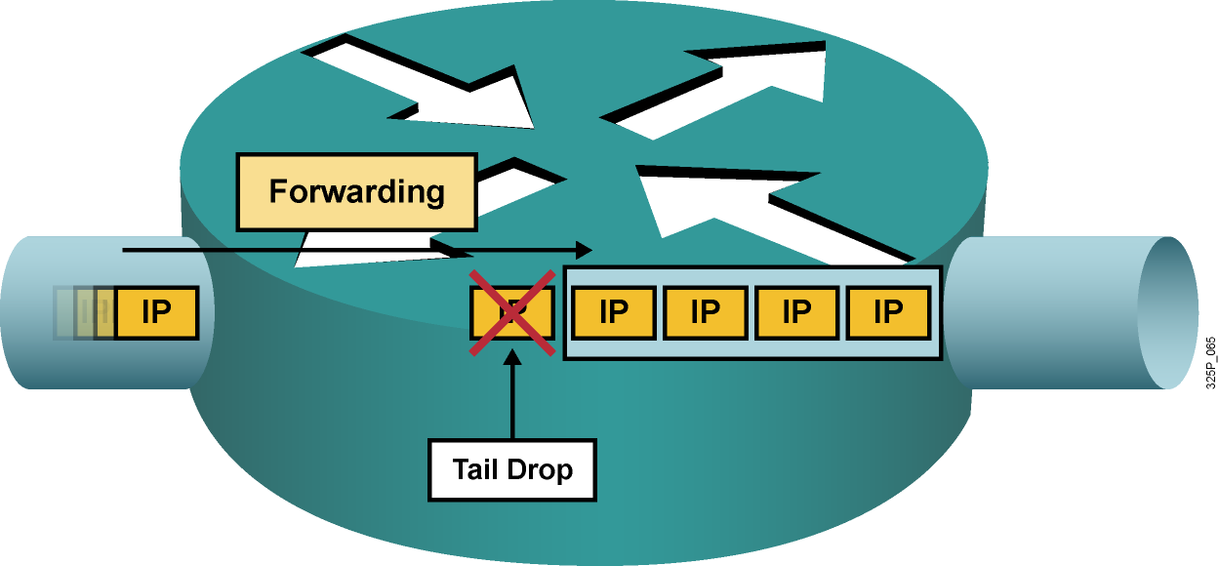
Druhy strát paketov
Straty typu „tail drop“ nastávajú, keď je výstupný front plný. Tieto straty sú bežné a nastávajú pri zahltení výstupného rozhrania
Iné druhy strát sú obvykle spôsobené zahltením na vstupnom rozhraní, pomalým procesorom či chybami pri prenose. Tieto chyby sa často dajú odstrániť upgradom hardvéru
Notes:
This graphic illustrates a full interface output queue, which causes newly arriving packets to be dropped. The term that is used for such drops is “output drop” or “tail drop” (packets are dropped at the tail of the queue).
Routers might also drop packets for other less common reasons:
Input queue drop: The main CPU is busy and cannot process packets (the input queue is full).
Ignore: The router runs out of buffer space.
Overrun: The CPU is busy and cannot assign a free buffer to the new packet.
Frame errors: The hardware detects an error in a frame; for example, cyclic redundancy checks (CRCs), runt, and giant.

Slide 20
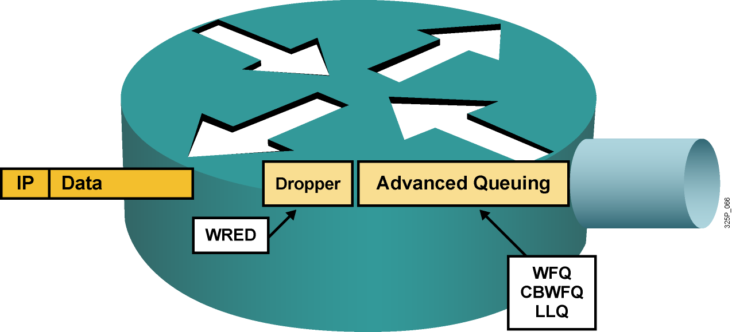
Predchádzanie stratám
Zrýchliť linku (najlepšie, ale aj najdrahšie riešenie)
Garantovať dostatočné pásmo pre citlivé pakety
Predchádzať zahlteniu náhodným zahadzovaním menej dôležitých paketov ešte skôr, než dôjde k zahlteniu
Notes:
Packet loss is usually the result of congestion on an interface. Most applications that use TCP experience slowdown because TCP automatically adjusts to network congestion. Dropped TCP segments cause TCP sessions to reduce their window sizes. Some applications do not use TCP and cannot handle drops (fragile flows).
These approaches prevent drops in sensitive applications:
Increase link capacity to ease or prevent congestion.
Guarantee enough bandwidth and increase buffer space to accommodate bursts of traffic from fragile flows. There are several mechanisms available in Cisco IOS QoS software that can guarantee bandwidth and provide prioritized forwarding to drop-sensitive applications.
Prevent congestion by dropping lower-priority packets before congestion occurs. Cisco IOS QoS provides queuing mechanisms that start dropping lower-priority packets before congestion occurs.

Slide 21
Nástroje pre poskytovanie QoS
Klasifikácia
Identifikácia toku alebo triedy prevádzky
Značkovanie (Marking)
Vyznačenie identifikovaného toku alebo triedy prevádzky
Predchádzanie zahlteniu (Congestion Avoidance)
Tail Drop, Random Early Detection, Weighted RED
Riešenie zahltenia (Congestion Management)
Plánovacie mechanizmy pre obsluhu frontov
Tvarovanie a obmedzovanie prevádzky (Shaping, Policing)
Mechanizmy efektívnosti linky (Link Efficiency Mechanisms)
Link Fragmentation and Interleaving
On-the-fly kompresia hlavičiek alebo tiel paketov

Slide 22
Notes:
A communications network forms the backbone of any successful organization. These networks transport a multitude of applications and data, including high-quality video and delay-sensitive data such as real-time voice. The bandwidth-intensive applications stretch network capabilities and resources, but also complement, add value, and enhance every business process. Networks must provide secure, predictable, measurable, and sometimes guaranteed services. Achieving the required Quality of Service (QoS) by managing the delay, delay variation (jitter), bandwidth, and packet loss parameters on a network becomes the secret to a successful end-to-end business solution. Thus, QoS is the set of techniques to manage network resources.

Slide 23
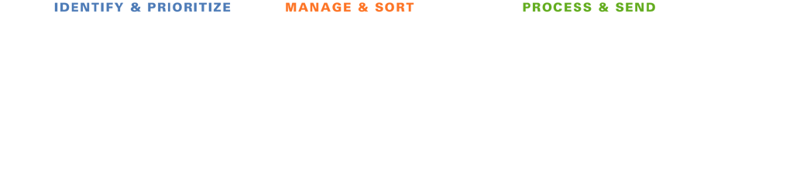







Ako QoS nástroje pracujú?
Klasifikácia a značkovanie
Ukladanie do frontov (Selektívne) zahadzovanie
Činnosti po uložení do frontu
Notes:
In this illustration, the packages on the conveyer belt represent data packets moving through the network.
As packets move through each phase, they are identified and prioritized, then managed and sorted, and finally processed and sent.
As the packets are identified, they are sorted into separate queues. Notice how some packets receive priority (more of these packets are processed over time), and some packets are selectively dropped.
In the next lessons, we will examine in detail the mechanisms used to support these processes.

Slide 24

Modely poskytovania QoS

Slide 25
Modely poskytovania kvality služby
Model | Popis
Best effort | Bez riadenia kvality služby. Vhodné, ak nie je dôležité, kedy alebo v akom poradí budú pakety doručené.
Integrated Services (IntServ) | Aplikácie oznamujú sieti, aké QoS parametre požadujú pre ich správnu činnosť.
Differentiated Services (DiffServ) | Sieť rozoznáva triedy prevádzky, ktoré vyžadujú osobitné QoS parametre.
Notes:
IP without QoS provides best effort service:
All packets are treated equally
Bandwidth is unpredictable
Delay and jitter are unpredictable
Cisco IOS Software supports two fundamental Quality of Service architectures: Differentiated Services (DiffServ) and Integrated Services (IntServ).
In the DiffServ model a packet's "class" can be marked directly in the packet, which contrasts with the IntServ model where a signaling protocol is required to tell the routers which flows of packets requires special QoS treatment. DiffServ achieves better QoS scalability, while IntServ provides a tighter QoS mechanism for real-time traffic. These approaches can be complimentary and are not mutually exclusive.

Slide 26
Model Best-Effort
Model best-effort je pôvodným modelom, na ktorom bol Internet založený
Medzi tokmi dát nie je nijaká diferenciácia
Doručovanie sa podobá obyčajnej poštovej zásielke
Paket „príde vtedy, keď príde“
Výhody:
Vynikajúca škálovateľnosť
Nie je potrebný nijaký osobitný mechanizmus
Nevýhody:
Neposkytuje garancie služby
Nediferencuje medzi službami
Notes:
The basic design of the Internet provides for best-effort packet delivery and provides no guarantees. This approach is still predominant on the Internet today and remains appropriate for most purposes. The best-effort model treats all network packets in the same way, so an emergency voice message is treated the same way a digital photograph attached to an e-mail is treated. Without QoS, the network cannot tell the difference between packets and, as a result, cannot treat packets preferentially.
When you mail a letter using standard postal mail, you are using a best-effort model. Your letter is treated exactly the same as every other letter. With the best-effort model, the letter may never arrive, and, unless you have a separate notification arrangement with the letter recipient, you may never know that the letter did not arrive.
Benefits:
The model has nearly unlimited scalability. The only way to reach scalability limits is to reach bandwidth limits, in which case all traffic is equally affected.
You do not need to employ special QoS mechanisms to use the best-effort model. Best-effort is the easiest and quickest model to deploy.
Drawbacks:
There are no guarantees of delivery. Packets will arrive whenever they can and in any order possible, if they arrive at all.
No packets have preferential treatment. Critical data is treated the same as casual e‑mail is treated.

Slide 27
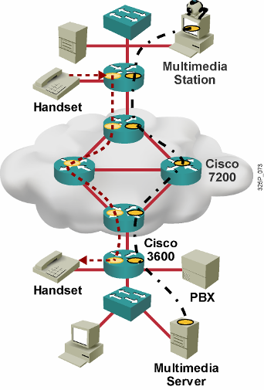
Model Integrated Services (IntServ)
Poskytuje garantované doručenie a predikovateľné správanie sa siete voči aplikáciám
Poskytuje viaceré úrovne služieb
Kľúčovým podporným protokolom je RSVP na signalizáciu QoS požiadaviek pre jednotlivé toky
QoS parametre sa vzťahujú na jednotlivé toky medzi jednotlivými uzlami a aplikáciami
Ak sieť nie je schopná splniť požiadavku aplikácie na QoS parametre, bude o tom aplikáciu informovať
Potrebné sú inteligentné frontové mechamizmy na poskytovanie rezervácie zdrojov:
Garantovaná rýchlosť
Riadená záťaž (nízke oneskorenie, vysoká priepustnosť)
Notes:
Integrated Services (IntServ) provides a way to deliver the end-to-end QoS that real-time applications require by explicitly managing network resources to provide QoS to specific user packet streams, sometimes called microflows. IntServ uses resource reservation and admission-control mechanisms as key building blocks to establish and maintain QoS. This practice is similar to a concept known as “hard QoS.” Hard QoS guarantees traffic characteristics, such as bandwidth, delay, and packet-loss rates, from end to end. Hard QoS ensures both predictable and guaranteed service levels for mission-critical applications.
IntServ uses Resource Reservation Protocol (RSVP) explicitly to signal the QoS needs of an application’s traffic to devices along the end-to-end path through the network. If network devices along the path can reserve the necessary bandwidth, the originating application can begin transmitting. If the requested reservation fails along the path, the originating application does not send any data.
In the IntServ model, the application requests a specific kind of service from the network before sending data. The application informs the network of its traffic profile and requests a particular kind of service that can encompass its bandwidth and delay requirements. The application sends data only after it receives confirmation for bandwidth and delay requirements from the network.
The network performs admission control based on information from the application and available network resources. The network commits to meeting the QoS requirements of the application as long as the traffic remains within the profile specifications. The network fulfills its commitment by maintaining the per-flow state and then performing packet classification, policing, and intelligent queuing based on that state.

Slide 28
Procesy a architektúra smerovača v IntServ
Control Plane
Routing Selection
Admission Control
Reservation Setup
Reservation Table
Data Plane
Flow Identification
Packet Scheduler
Notes:
As a means of illustrating the function of the IntServ model, this graphic shows the control and data planes. In addition to end-to-end signaling, IntServ requires several functions in order to be available on routers and switches along the network path. These functions include the following:
Admission control: Admission control determines whether a new flow requested by users or systems can be granted the requested QoS without affecting existing reservations in order to guarantee end-to-end QoS. Admission control ensures that resources are available before allowing a reservation.
Classification: Entails using a traffic descriptor to categorize a packet within a specific group to define that packet and make it accessible for QoS handling on the network. Classification is pivotal for policy techniques that select packets for different types of QoS service.
Policing: Takes action, including possibly dropping packets, when traffic does not conform to its specified characteristics. Policing is defined by rate and burst parameters, as well as by actions for in-profile and out-of-profile traffic.
Queuing: Queuing accommodates temporary congestion on an interface of a network device by storing excess packets in buffers until access to the bandwidth becomes available.
Scheduling: A QoS component, the QoS scheduler, negotiates simultaneous requests for network access and determines which queue receives priority. IntServ uses round robin scheduling. Round robin scheduling is a time-sharing approach in which the scheduler gives a short time slice to each job before moving on to the next job, polling each task round and round. This way, all the tasks advance, little by little, on a controlled basis. Packet scheduling enforces the reservations by queuing and scheduling packets for transmission.

Slide 29
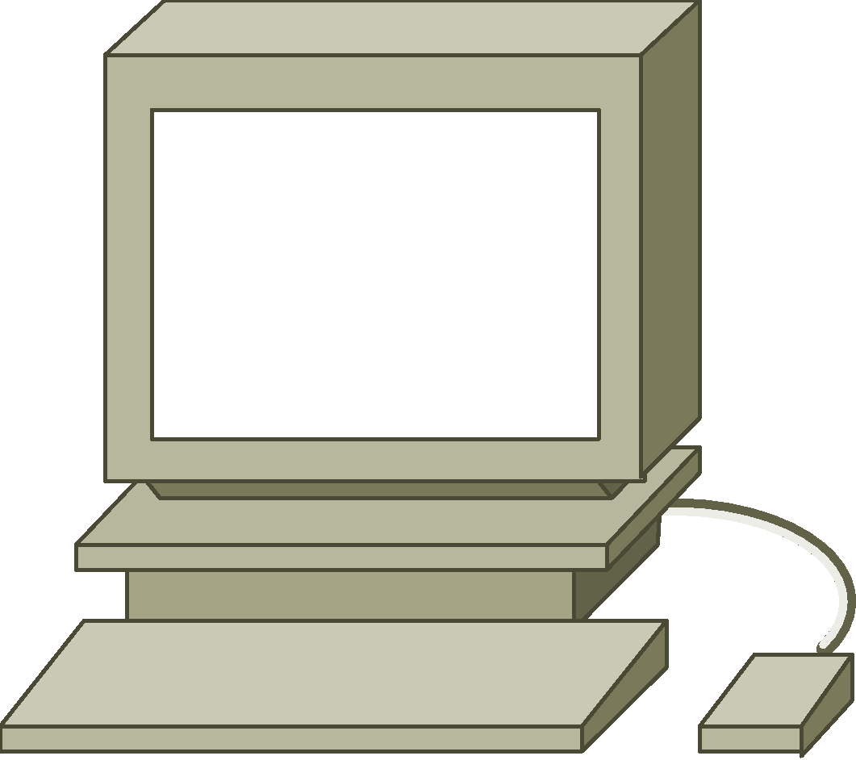



Resource Reservation Protocol (RSVP)
Prenáša sa v IP – číslo protokolu 46
Môže využiť aj TCP/UDP port 3455
Jedná sa o signalizačný protokol a spolupracuje so smerovacími protokolmi
Slúži na rezerváciu QoS prostriedkov na všetkých zariadeniach medzi odosielateľom a príjemcom
Sending Host
RSVP Tunnel
RSVP Receivers
Zabezpečuje prostriedky pre rôznorodé multimediálne aplikácie
Premávka citlivá na prenosové pásmo
Premávka citlivá na oneskorenie
Notes:
Resource Reservation Protocol (RSVP) is used to implement IntServ models.
The Resource Reservation Protocol (RSVP) is a network-control protocol that enables Internet applications to obtain differing qualities of service (QoS) for their data flows. Such a capability recognizes that different applications have different network performance requirements. Some applications, including the more traditional interactive and batch applications, require reliable delivery of data but do not impose any stringent requirements for the timeliness of delivery. Newer application types, including videoconferencing, IP telephony, and other forms of multimedia communications require almost the exact opposite: Data delivery must be timely but not necessarily reliable. Thus, RSVP was intended to provide IP networks with the capability to support the divergent performance requirements of differing application types.
It is important to note that RSVP is not a routing protocol. RSVP works in conjunction with routing protocols and installs the equivalent of dynamic access lists along the routes that routing protocols calculate. Thus, implementing RSVP in an existing network does not require migration to a new routing protocol.
If resources are available, RSVP accepts a reservation and installs a traffic classifier to assign a temporary QoS class for that traffic flow in the QoS forwarding path. The traffic classifier tells the QoS forwarding path how to classify packets from a particular flow and what forwarding treatment to provide.
RSVP is an IP protocol that uses IP protocol ID 46 and TCP and UDP port 3455.
In RSVP, a data flow is a sequence of datagrams that have the same source, destination (regardless of whether that destination is one or more physical machines), and QoS requirements. QoS requirements are communicated through a network via a flow specification. A flow specification describes the level of service that is required for that data flow.
RSVP focuses on the following two main traffic types:
Rate-sensitive traffic: Traffic that requires a guaranteed and constant (or nearly constant) transmission rate from its source to its destination. An example of such an application is H.323 videoconferencing. RSVP enables constant-bit-rate service in packet-switched networks via its rate-sensitive level of service. This service is sometimes referred to as guaranteed-bit-rate service.
Delay-sensitive traffic: Traffic that requires timeliness of delivery and that varies its rate accordingly. MPEG-II video, for example, averages about 3 to 7 Mbps, depending on the rate at which the picture is changing. RSVP services supporting delay-sensitive traffic are referred to as controlled-delay service (non-real-time service) and predictive service (real-time service).

Slide 30
Výhody a nevýhody modelu IntServ
Výhody:
Explicitné riadenie prístupu k zdrojom (end to end)
Veľmi vysoká granularita prideľovania QoS prostriedkov
Riadenie prístupu k prostriedkom na každú žiadosť individuálne
Signalizácia dynamických čísel portov (napr pre H.323)
Nevýhody:
Potreba trvalej signalizácie vzhľadom na stavovú architektúru
Tokovo orientovaný prístup nie je škálovateľné na siete veľkého rozsahu, ako napr. Internet
Notes:
Benefits:
IntServ supports admission control that allows a network to reject or downgrade new RSVP sessions if one of the interfaces in the path has reached the limit (that is, if all bandwidth that can be reserved is booked).
RSVP signals QoS requests for each individual flow. In the request, the authorized user (authorization object) and needed traffic policy (policy object) are sent. The network can then provide guarantees to these individual flows.
RSVP informs network devices of flow parameters (IP addresses and port numbers). Some applications use dynamic port numbers, such as H.323-based applications, which can be difficult for network devices to recognize. Network-Based Application Recognition (NBAR) is a mechanism that complements RSVP for applications that use dynamic port numbers but do not use RSVP.
Drawbacks:
There is continuous signaling because of the stateful RSVP architecture that adds to the bandwidth overhead. RSVP continues signaling for the entire duration of the flow. If the network changes, or links fail and routing convergence occurs, the network may no longer be able to support the reservation.
The flow-based approach is not scalable to large implementations, such as the public Internet, because RSVP has to track each individual flow. This circumstance makes end-to-end signaling difficult. A possible solution is to combine IntServ with elements from the DiffServ model to provide the needed scalability.

Slide 31






Model Differentiated Services
Za cenu istých kompromisov rieši mnohé obmedzenia modelov Best-Effort a IntServ
Na rozdiel od signalizovaných tvrdých požiadaviek na QoS využíva dopredu pripravené QoS prostriedky a politiky
Toky triedi do tzv. agregátov (tried) a poskytuje QoS prostriedky celým triedam
Minimalizuje signalizáciu (žiadna) a stavovú informáciu (minimálna) na sieťových uzloch
QoS parametre charakterizuje popisom tzv. Per-Hop Behavior (PHB)
Úroveň služby sa stanovuje na triedu prevádzky, nie na individuálne toky
Edge
End Station
Edge
Interior
Edge
DiffServ Domain
End Station
Notes:
The differentiated services (DiffServ) architecture specifies a simple, scalable, and coarse-grained mechanism for classifying and managing network traffic and providing QoS guarantees. For example, DiffServ can provide low-latency guaranteed service (GS) to critical network traffic such as voice or video while providing simple best-effort traffic guarantees to non-critical services such as web traffic or file transfers.
The DiffServ design overcomes the limitations of both the best-effort and IntServ models. DiffServ can provide an “almost guaranteed” QoS while still being cost-effective and scalable.
The concept of soft QoS is the basis of the DiffServ model. You will recall that IntServ (hard QoS) uses signaling in which the end-hosts signal their QoS needs to the network. DiffServ does not use signaling but works on the provisioned-QoS model, where network elements are set up to service multiple classes of traffic each with varying QoS requirements. By classifying flows into aggregates (classes), and providing appropriate QoS for the aggregates, DiffServ can avoid significant complexity, cost, and scalability issues.
For example, DiffServ groups all TCP flows as a single class, and allocates bandwidth for that class, rather than for the individual flows as hard QoS (DiffServ) would do. In addition to classifying traffic, DiffServ minimizes signaling and state maintenance requirements on each network node.
DiffServ divides network traffic into classes based on business requirements. Each of the classes can then be assigned a different level of service. As the packets traverse a network, each of the network devices identifies the packet class and services the packet according to that class.
The hard QoS model (IntServ) provides for a rich end-to-end QoS solution, using end-to-end signaling, state-maintenance and admission control. This approach consumes significant overhead, thus restricting its scalability. On the other hand, DiffServ cannot enforce end-to-end guarantees, but is a more scalable approach to implementing QoS. DiffServ maps many applications into small sets of classes. DiffServ assigns each class with similar sets of QoS behaviors and enforces and applies QoS mechanisms on a hop-by-hop basis, uniformly applying global meaning to each traffic class to provide both flexibility and scalability.
DiffServ works like a packet delivery service. You request (and pay for) a level of service when you send your package. Throughout the package network, the level of service is recognized and your package is given either preferential or normal service, depending on what you requested.
Benefits:
Highly scalable
Many levels of quality possible
Drawbacks:
No absolute service guarantee
Requires a set of complex mechanisms to work in concert throughout the network

Slide 32
Model Differentiated Services (DiffServ)
Model DiffServ sa zaoberá poskytovaním QoS nad triedami prevádzky, nie nad jednotlivými tokmi
Komplexná klasifikácia, značkovanie a vstupné úpravy prevádzky sa realizujú na okraji siete
Vo vnútri siete sa QoS pravidlá riadia už iba pridelenými značkami
Vo vnútri siete sa neudržiavajú informácie o jednotlivých tokoch, udržiavajú sa len informácie o spôsobe obsluhy jednotlivých tried prevádzky
Cieľom DiffServ je
Škálovateľnosť
Spolupráca s uzlami, ktoré ešte nepodporujú DiffServ
Možnosť postupného nasadzovania
Notes:
In contrast to integrated service (IntServ), which is a fine-grained, flow-based mechanism, differentiated service (DiffServ) is a coarse-grained, class-based mechanism for traffic management. DiffServ architecture is based on a simple model in which data packets are placed into a limited number of traffic classes, rather than differentiating network traffic based on the requirements of an individual flow.
Each traffic class can be managed differently, insuring preferential treatment for higher-priority traffic on the network.
One of the primary principles of DiffServ is that you should mark packets as close to the edge of the network as possible. It is often a difficult and time-consuming task to determine which traffic class a data packet belongs to. You want to classify the data as few times as possible. By marking the traffic at the network edge, core network devices and other devices along the forwarding path will be able to quickly determine the proper CoS to apply to a given traffic flow.
A key benefit of DiffServ is ease of scalability in comparison to IntServ.

Slide 33
Klasifikačné nástroje IP Precedence a DiffServ Code Point
Version Length
ToS
Byte
Len
ID
Offset
TTL
Proto
FCS
IP SA
IP DA
Data
IPv4 Paket
7
6
5
4
3
2
1
0
Štandard IPv4
IP Precedence
Unused
DiffServ Code Point (DSCP)
IP ECN
Rozšírenie DiffServ
IPv4: tri najvyššie bity ToS bajtu sa nazývajú IP Precedence (IPP). Ostatné bity boli niekoľkokrát predefinované (Delay, Throughput, Reliability, Monetary cost)
DiffServ: šesť najvyšších bitov ToS bajtu sa nazývajú DiffServ Code Point (DSCP). Zvyšné dva bity sa využívajú na explicitnú informáciu o zahltení (ECN). Hodnota DSCP poľa sa nazýva codepoint
Hodnoty DSCP sú spätne kompatibilné s hodnotami IP Precedence
Notes:
• IP Type of Service Byte—As Layer 2 media often changes as packets traverse from source to destination, a more ubiquitous classification would occur at Layer 3. The second byte in an IPv4 packet is the Type of Service (ToS) byte. The first three bits of the ToS byte alone are referred to as the IP Precedence (IPP) bits. These same three bits, in conjunction with the next three bits, are known collectively as the DSCP bits.
The IP Precedence bits, like 802.1p CoS bits, allow for only 8 values of marking (0-7).
IPP values 6 and 7 are generally reserved for network control traffic (such as routing).
IPP value 5 is recommended for voice.
IPP value 4 is shared by video conferencing and streaming video.
IPP value 3 is for voice-control.
IPP values 1 and 2 can be used for data applications.
IPP value 0 is the default marking value.
Many enterprises find IPP marking to be overly restrictive and limiting, favoring instead the 6-Bit/64-value DSCP marking model.

Slide 34
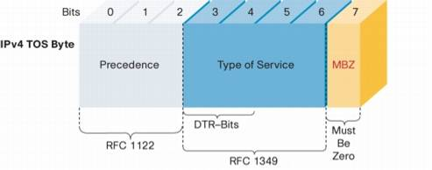
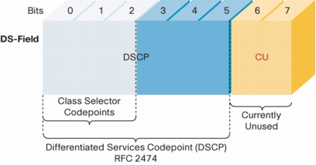
IP ToS a DS pole v IP hlavičke
Notes:
To support DiffServ, the IPv4 Type of Service (ToS) octet has been redefined from the 3-bit IP-precedence to a 6-bit DSCP field.
Prior to DiffServ, IP networks could use the Precedence field in the Type of Service (TOS) byte of the IP header to mark priority traffic.
As the TOS byte and IP precedence was not widely used, the IETF agreed to reuse the TOS byte as the DS field for DiffServ networks. In order to maintain backward compatibility with network devices that still use the Precedence field, DiffServ defines the Class Selector PHB.
The Class Selector codepoints are of the form 'xxx000'. The first three bits are the IP precedence bits. Each IP precedence value can be mapped into a DiffServ class. If a packet is received from a non-DiffServ aware router that used IP precedence markings, the DiffServ router can still understand the encoding as a Class Selector codepoint.

Slide 35
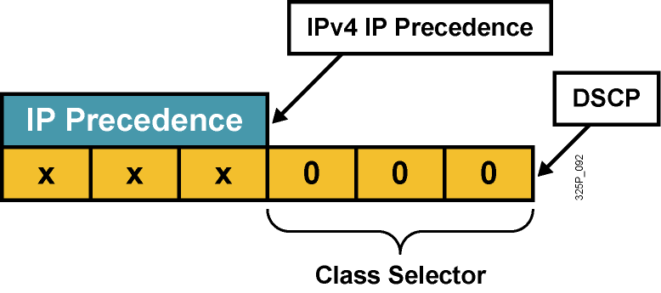
Kompatibilita IP Precedence a DSCP
Pre zachovanie kompatibility s IP Precedence (RFC 1812) boli zavedené tzv. Class Selector codepoints v tvare xyz000 s názvom CS0 až CS7
Odlišuje pravdepodobnosť včasného vybavenia paketu:
(xyz000) >= (abc000), ak xyz >= abc
Napríklad, ak má paket DSCP codepoint 011000 (CS3), má väčšiu pravdepodobnosť včasného odoslania než paket s DSCP 001000 (CS1)
Notes:
RFC 2474 replaced the ToS field with the DiffServ field, in which a range of eight values (class selector) is used for backward compatibility with IP precedence. There is no compatibility with other bits used by the ToS field.
The class selector Per Hop Behavior (PHB) was defined to provide backward compatibility for DSCP with ToS-based IP precedence.
RFC 1812 simply prioritizes packets according to the precedence value. In this sense, the PHB is defined as the probability of timely forwarding.
For example, consider a service provider offering so-called “Olympic” service classes (Gold, Silver, and Bonze) so that packets in the gold class experience lighter load, and thus have greater probability for timely forwarding, than packets assigned to the silver class. Packets with higher IP precedence should be (on average) forwarded in less time than packets with lower IP precedence.
The last 3 bits of the DSCP (bits 2 to 4) set to 0 identify a class-selector PHB.

Slide 36
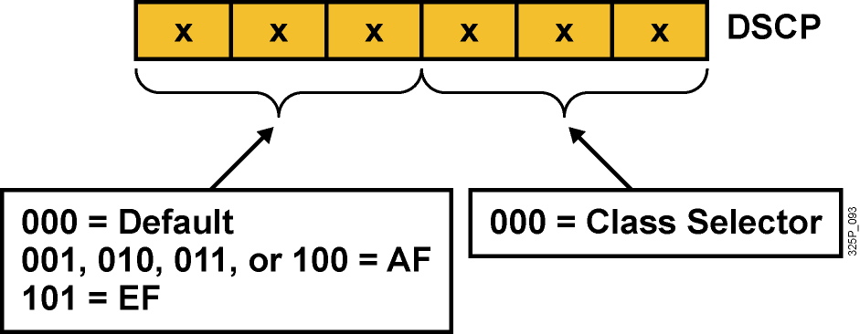
Per-Hop Behavior – PHB
PHB je spôsob obsluhy konkrétnej triedy prevádzky na danom uzle
DSCP vlastne vyberá PHB pozdĺž siete
Default PHB (FIFO, tail drop)
Class-selector PHB (IP precedence)
EF PHB (Expedited Forwarding)
AF PHB (Assured Forwarding)
Notes:
Now that packets can be marked using the DSCP, how do we provide meaningful CoS, and provide the QoS that is needed?
First, the collection of packets that have the same DSCP value (also called a codepoint) in them, and crossing in a particular direction is called a Behavior Aggregate (BA)…more about this later. Packets from multiple applications/sources could belong to the same BA.
Formally, RFC-2475 defines a Per Hop Behavior (PHB) as the externally observable forwarding behavior applied at a DS-compliant node to a DS BA. In more concrete terms, a PHB refers to the packet scheduling, queuing, policing, or shaping behavior of a node on any given packet belonging to a BA, and as configured by a Service Level Agreement (SLA) or policy.
To date, four standard PHBs are available to construct a DiffServ-enabled network and achieve coarse-grained, end-to-end CoS and QoS: Default, EF, AF and Class-selector.
PHBs are defined in terms of behavior characteristics relevant to service provisioning policies, and not in terms of particular implementation mechanisms. In general, a variety of implementation mechanisms may be suitable for implementing a particular PHB group.
The DiffServ architecture defines the DiffServ (DS) field to make per-hop behavior (PHB) decisions about packet classification and traffic conditioning functions, such as metering, marking, shaping, and policing.
The Default PHB (Defined in RFC-2474)
The default PHB specifies that a packet marked with a DSCP value (recommended) of `000000' gets the traditional best effort service from a DS-compliant node (a network node that complies to all the core DiffServ requirements). Also, if a packet arrives at a DS-compliant node and its DSCP value is not mapped to any of the other PHBs, it will get mapped to the default PHB.
Class-Selector PHBs (Defined in RFC-2474)
To preserve backward compatibility with the IP-precedence scheme, DSCP values of the form `xxx000,' where x is either 0 or 1, are defined. These codepoints are called class-selector codepoints. The PHB associated with a class-selector codepoint is a class-selector PHB. These PHBs retain almost the same forwarding behavior as nodes that implement IP-precedence based classification and forwarding. For example, packets with a DSCP value of `110000' (IP-precedence 110) have a preferential forwarding treatment (scheduling, queuing, etc.) as compared to packets with a DSCP value of `100000' (IP-precedence 100). These PHBs ensure that DS-compliant nodes can co-exist with IP-precedence aware nodes, with the exception of the DTS bits.
EF PHB (described in following slides)
AF PHB (described in following slides)

Slide 37
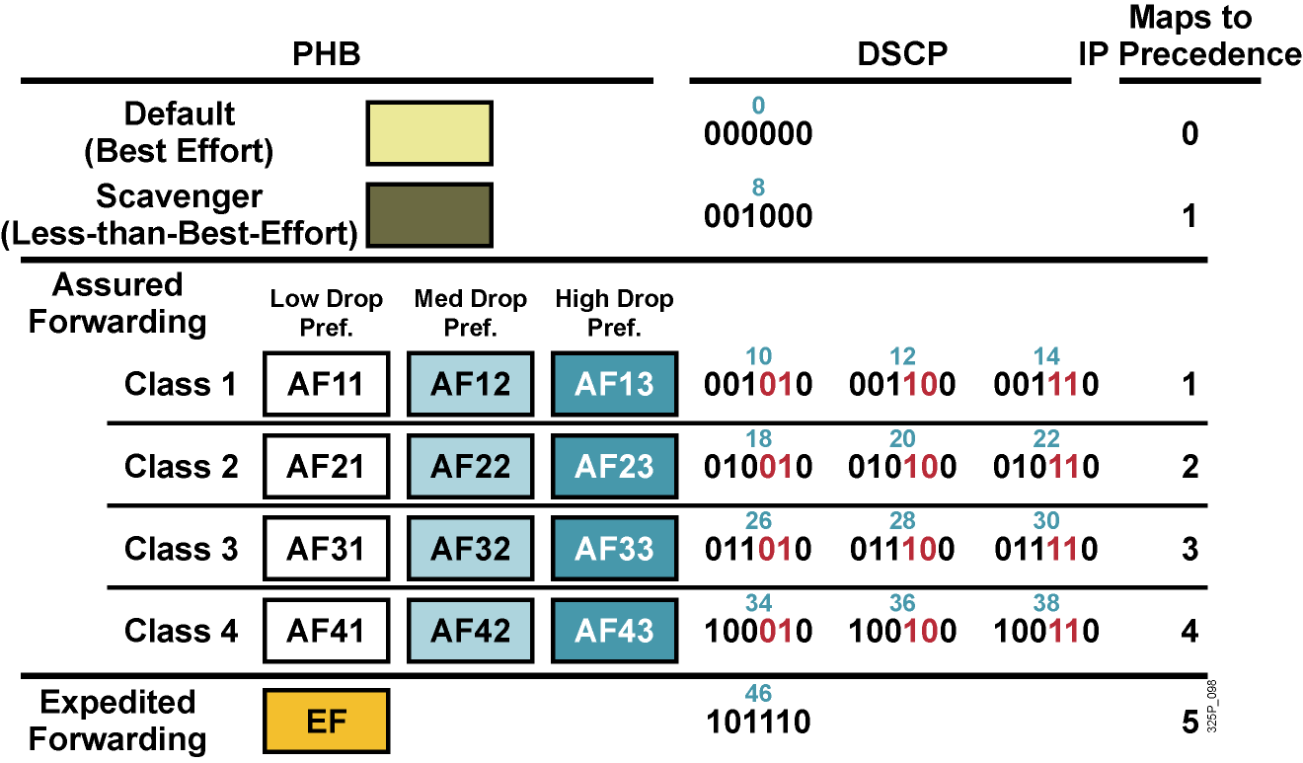
Štandardné PHB skupiny
Notes:
Standard PHBs are available to construct a DiffServ-enabled network and achieve coarse-grained, end-to-end CoS and QoS.
Default PHB (as defined in RFC 2474)
AF PHB (as defined in RFC 2597)
EF PHB (as defined in RFC 2598) class-selector PHB (as defined in RFC 2474)

Slide 38
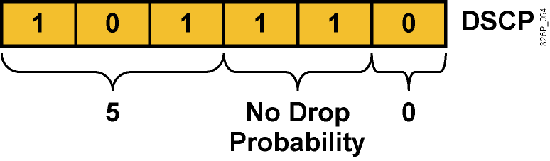
Expedited Forwarding (EF) PHB
EF PHB:
Garantuje tzv. minimum departure rate – právo prednostného odoslania
Garantuje prenosové pásmo vyhradené pre triedu prevádzky s EF
Limituje pásmo pomocou policingu – trieda s EF nemôže prekročiť garantované pridelené pásmo
DSCP codepoint 101110 (46): Pre zariadenia podporujúce len IPP je to precedencia 5:
Bity 5 až 7: 101 = 5 (rovnaké 3 bity použité pre IP Precedence)
Bity 3 a 4: 11 = Bez strát (low delay, high throughput)
Bit 2: Nastavený na 0
Notes:
The Expedited Forwarding (EF) PHB is the key ingredient in DiffServ for providing a low-loss, low-latency, low-jitter, and assured bandwidth service. Applications such as VoIP, video, and online trading programs require a robust network-treatment. EF can be implemented using priority queuing, along with rate limiting on the class (formally, a BA).
Although EF PHB when implemented in a DiffServ network provides a premium service, it should be specifically targeted toward the most critical applications, because if congestion exists, it is not possible to treat all or most traffic as high priority. EF PHB is especially suitable for applications (like VoIP) that require very low packet loss, guaranteed bandwidth, low delay and low jitter.
Packets requiring EF should be marked with DSCP binary value 101110 (46 or 0x2E).
Non-DiffServ-compliant devices regard EF DSCP value 101110 as IP precedence 5 (101). This precedence is the highest user-definable IP precedence and is typically used for delay-sensitive traffic (such as VoIP). Bits 5 to 7 of the EF DSCP value are 101, which matches IP precedence 5 and allows backward compatibility.

Slide 39
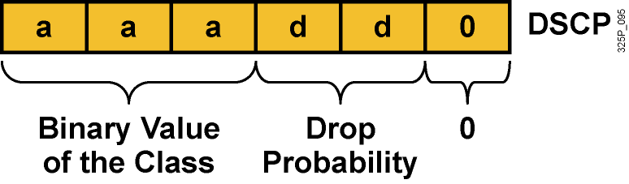
Assured Forwarding (AF) PHB
AF PHB:
Garantuje isté minimálne prenosové pásmo
Umožňuje využiť aj väčie pásmo, ak je momentálne k dispozícii
Štyri základné kategórie: AF1, AF2, AF3 a AF4
DSCP codepoint má tvar aaadd0:
aaa je binárne číslo triedy (1, 2, 3 alebo 4)
dd je pravdepodobnosť zahodenia
Notes:
The AF PHB is identified based on the following:
The AF PHB guarantees a certain amount of bandwidth to an AF class.
The AF PHB allows access to extra bandwidth, if available.
Packets requiring AF PHB should be marked with DSCP value aaadd0, where aaa is the number of the class and dd is the drop probability.
There are four standard AF classes defined: AF1, AF2, AF3, and AF4. Each class should be treated independently and should have allocated bandwidth that is based on the QoS policy.
AF PHB defines a method by which BAs can be given different forwarding assurances. For example, traffic can be divided into gold, silver, and bronze classes, with gold being allocated 50 percent of the available link bandwidth, silver 30 percent, and bronze 20 percent.

Slide 40
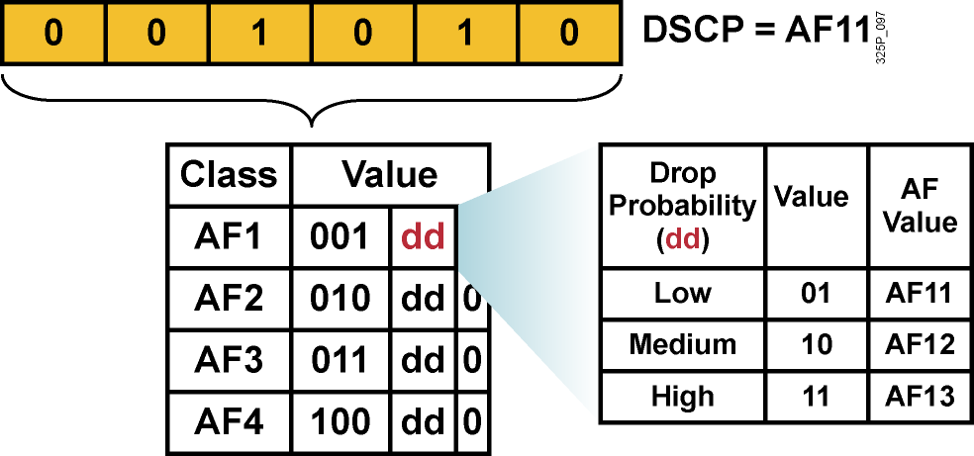
Hodnoty AF PHB
Každá AF trieda využíva 3 DSCP hodnoty
Každá AF trieda sa preposiela nezávisle od ostatných so svojou garantovanou šírkou pásma
Aby sa predišlo zahlteniu, v každej triede sa používajú techniky predchádzania zahlteniu – Weighted RED (WRED)
Ak je daná trieda AFxy, dekadickú hodnotu DSCP vypočítame ako 8x+2y
Notes:
Within each AFx class, it is possible to specify 3 drop precedence values. If there is congestion in a DS-node on a specific link, and packets of a particular AF class (for example AF1) need to be dropped, packets will be dropped such that the probability of drop creates a relationship where AFx1 <= AFx2 <= AFx3.
In other words, packets in AF13 will get dropped before packets in AF12, before packets in AF11. This concept of drop precedence is useful, for example, to penalize flows within a BA that exceed the assigned bandwidth. Packets of these flows could be re-marked by a policer to a higher drop precedence.

Slide 41
Vytváranie obslužných tried
Obslužné triedy sú typy prevádzky, ktoré budú vybavované rovnakým spôsobom (dostanú rovnakú QoS obsluhu)
Nie je vhodné vytvárať priveľa tried. Pre dátovú prevádzku obvykle stačí najviac 4-5 tried:
Hlasové aplikácie: VoIP
Mission-critical aplikácie: Oracle, SAP, SNA
Interaktívne aplikácie: Telnet, TN3270
Veľkoobjemové aplikácie: FTP, TFTP
Best-effort aplikácie: E-mail, web
Ostatné „smeti“: Kazaa, Yahoo, RapidShare
Do mission-critical a transakčných tried nezaraďovať viac ako tri aplikácie
Uprednostniť proaktívne pravidlá (WRED) pred reaktívnymi (policing)
Pred nasadením QoS pravidiel si nechať odsúhlasiť rozdelenie prevádzky na jednotlivé priority a ich pomery od vedenia spoločnosti
Notes:
One key element of defining QoS service classes is to understand the basic quality needs of network applications. It is essential that applications be given QoS treatment in line with their needs. For example, improperly specifying voice traffic into a service class with guaranteed bandwidth but without a guaranteed low latency (delay) would not meet the needs of the voice traffic.
While it is important to fully understand network application requirements, it is equally important not to overprovision or overdesign the administrative policy. An administrative policy should be proactive in nature and require as few service classes as necessary. One good rule is to limit the number of service classes to no more than four or five.
The QoS requirements of these applications can be met with a few well-designed service classes. The more service classes implemented in support of an administrative QoS policy, the more complex the QoS implementation will be. This complexity also extends to support and troubleshooting.
It is also important that the highest-priority classes be reserved for a select few applications. Marking 90 percent of network traffic as high priority will render most administrative QoS policies useless.

Slide 42
Koľko tried treba?
4/5 Class Model
8 Class Model
11 Class Model
Realtime
Voice
Voice
Interactive-Video
Video
Streaming Video
Call Signaling
Call Signaling
Call Signaling
Critical Data
Network Control
IP Routing
Network Management
Critical Data
Mission-Critical Data
Transactional Data
Bulk Data
Bulk Data
Best Effort
Best Effort
Best Effort
Scavenger
Scavenger
Scavenger
Čas
Notes:
Many enterprises aren’t ready to deploy a complex 11-Class Model, or may never have the need for 11 classes of service.
5-Classes is the recommended model for provisioning QoS for Voice, Video and Data.
Some of these classes can be gradually split into more granular classes, as shown in the diagram, as needed by the network.

Slide 43
Classification and Marking Design Odporúčania pre QoS Baseline Marking
Application
L3 Classification
L2
IPP
PHB
DSCP
CoS
Routing
6
CS6
48
6
Voice
5
EF
46
5
Video Conferencing
4
AF41
34
4
Streaming Video
4
CS4
32
4
Mission-Critical Data
3
AF31*
26
3
Call Signaling
3
CS3*
24
3
Transactional Data
2
AF21
18
2
Network Management
2
CS2
16
2
Bulk Data
1
AF11
10
1
Best Effort
0
0
0
0
Scavenger
1
CS1
8
1
Notes:
Cisco has adopted a new initiative called the “QoS Baseline.” The QoS Baseline is a strategic document designed to unify QoS within Cisco, from enterprise to service provider and from engineering to marketing. The QoS Baseline was written by Cisco's most qualified QoS experts.
The QoS Baseline specifies 11 traffic classes within the enterprise. An important note is that the QoS Baseline is not dictating that every enterprise deploy 11 different traffic classes immediately, but rather it is considering enterprise QoS needs of not only today, but also the foreseeable future. Even if an enterprise needs to provision for only a handful of these 11 classes today, following QoS Baseline recommendations will enable them to leave options open for smoothly provisioning additional traffic classes in the future.
Note: The QoS Baseline recommends marking Call-Signaling to CS3. Currently, however, all Cisco IP Telephony products mark Call-Signaling to AF31. A marking migration from AF31 to CS3 is planned within Cisco, but in the interim it is recommended that both AF31 and CS3 be reserved for Call-Signaling and that Locally-Defined Mission-Critical data applications be marked to DSCP 25. Upon completion of the migration, the QoS Baseline marking recommendations of CS3 for Call-Signaling and AF31 for Locally-Defined Mission-Critical applications should be used. These marking recommendations are more inline with RFC 2597 and RFC 2474.

